Slide 1

MACHINE LEARNING
Project
Suraj gadapa

Slide 2

Introduction
Problem statement:
We are trying to find out the main factors influencing the rating of a movie, like what factors influence the
most.
Does Rating Impact on Gross
Does cast impact on Gross Value.

Slide 3

Abstract
The project is about rating of the movie.
What are factors influencing the most.
To do that we used boxplots scatterplots to understand the data.
This Photo by Unknown Author is licensed under CC BY-NC

Slide 4
Approach
The algorithm used for the dataset is kmean “elbow method” and “silhouette method”
And compare both the methods and forecast how accurate our algorithm is:
After knowing the number of cluster and the k value we will know the insights of the data.
Using prcomp we will be knowing the important factors effects the predictions.
Their variance, standard deviation and cumulative proportion.

Slide 5
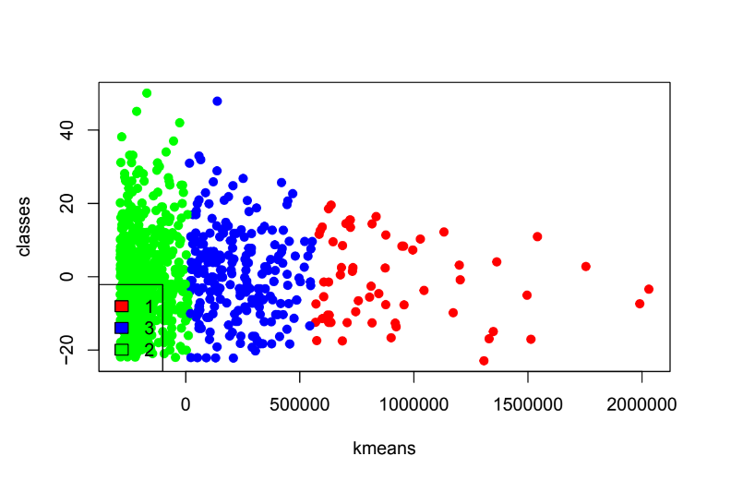
Conclusion
Clusters formation
Based on the model we conclude that number of votes and meta score effects the imdb rating of the movie.
The more the votes and the more the meta score, the higher the rating will be.

Slide 6
Thank you

